Slide 1
Employee data analysis using excel
Stundend name: sathya .j
Register no 312214279
Department: B.Com COMMERCE A/F
COLLEGE: ST.THOMAS CLG ARTS AND SCIENCE

Slide 2

project tittle
Employee salary analysis using excel

Slide 3
Agenda
Problem statement
Project overview
Who are the end users?
Our solution and its value proposition
Dataset description
Modelling
Result
Conclusion

Slide 4
Problem statement
A problem statement is a clear and concise description of the problem or issue a team aims to address in a project

Slide 5
Project overview
a project that includes the project’s goals, objectives, and how it will be executed. The purpose of a project overview is to provide a clear understanding of the project to stakeholders, clients, and team members. A project overview is usually included at the beginning of a project proposal, along with other documents that provide more detailed information about the project’s schedule and budget. A project overview is a detailed description of a project’s goals and objectives, the steps to achieve these goals, and the expected outcomes.

Slide 6
WHO ARE THE END OF USERS
An end user is a person or entity that uses a product or service. End users may or may not be the same as the customer who purchases the product or service.
For example, if a company buys software for its employees to use, the employees are the end users, but the company is the customer

Slide 7
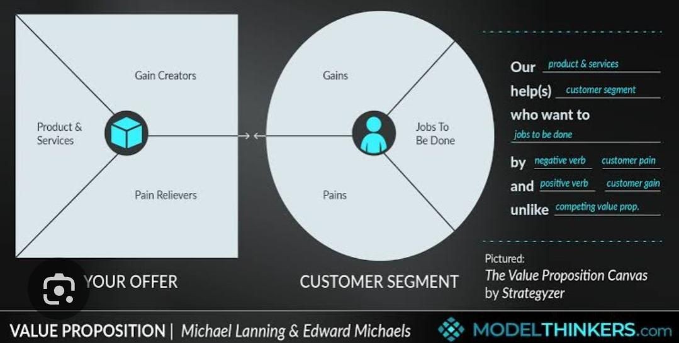
OUR SOLUTION AND ITS VALUE PROPOITION
“Employee Value Proposition, or EVP for short, is the unique value you as an employer offer your current employees and potential candidates. In short, an EVP could be explained as what you offer your employees that no one else offers.
An attractive EVP makes you stand out from the competition on the candidate market – making it easier to attract and hire top candidates within your target group.”

Slide 8
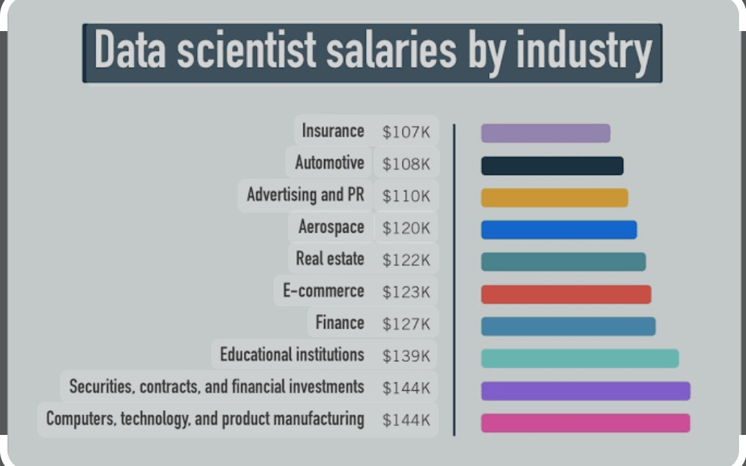
Dataset description
Salary data, also known as wage data, compensation data, or income data, is a sub-category of Business-to-Business (B2B) data.
The data is mainly grouped into ranges or categories relating to earnings, demographics and contracts.

Slide 9
ModElling
Average salary of model In india
According to Glassdoor, the average monthly salary for a model in India is ₹3,79,000, with an average additional cash compensation of ₹3,54,000. However, top models can earn significantly more, sometimes earning several lakh per show or campaign. According to Indeed, the average annual salary for a model in India is around ₹4,12,491.

Slide 10
Employee salary IN India
The average salary for an employee in India can vary depending on the source, but here are some estimates.
Glassdoor Reports an average monthly salary of ₹20,875, with an average additional cash compensationJoinHorizons Reports a national average monthly salary of ₹32,840, which is approximately $422 USD.

Slide 11
Calculation of Salary format
What is the formula for salary calculation?
Take-home Salary = Gross Salary – Income Tax – Employee’s PF contribution (PF) – Professional Tax. Gross Salary = CTC – Employer’s PF contribution (EPF) – Gratuity. Gratuity = (Basic salary + DA) × 15/26 × No. Of years of service.

Slide 12
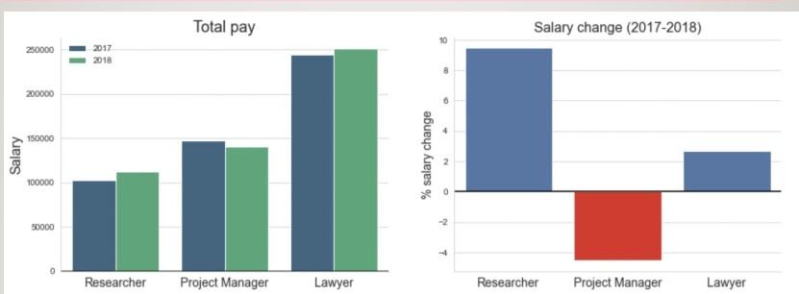
Result and Discussion

Slide 13
Conclusion
A conclusion is the final piece of writing in a research paper, essay, or article that summarizes the entire work.

